Slide 1
Swift Workshop
Part II

Slide 2
Xcode Basics

Slide 3
Exploring Xcode Interface

Slide 4
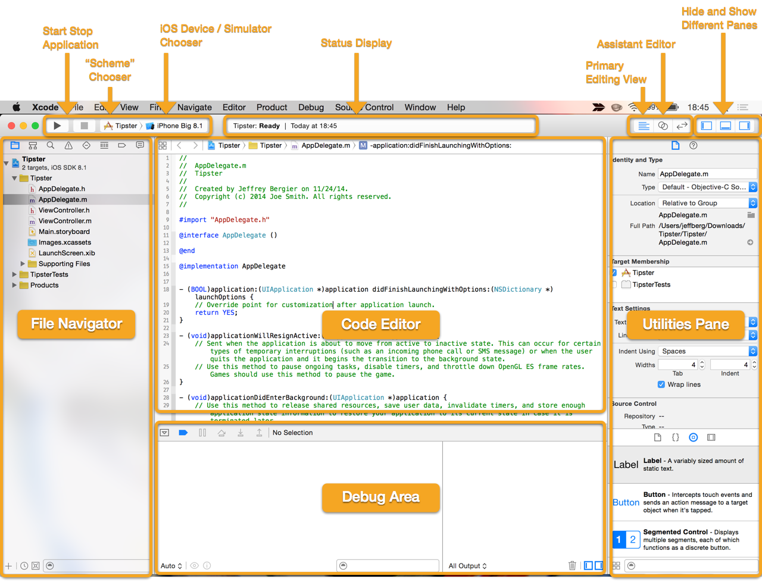
Xcode Interface

Slide 5
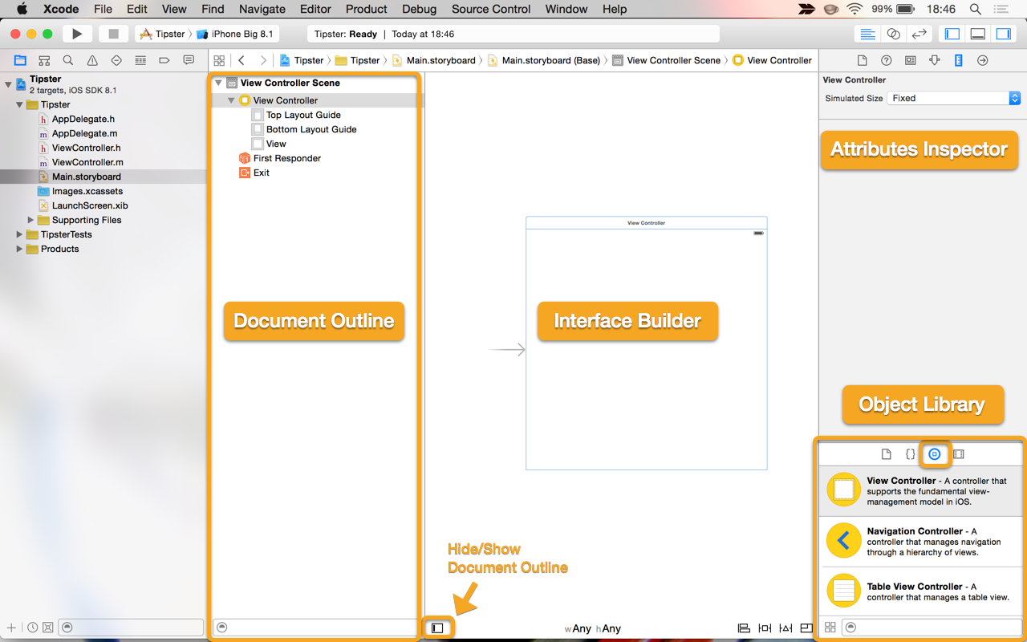
Interface Builder

Slide 6
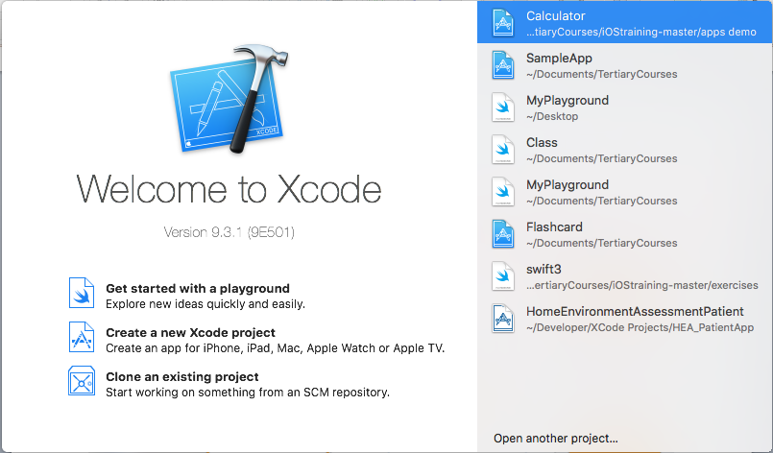
Create New Project

Slide 7
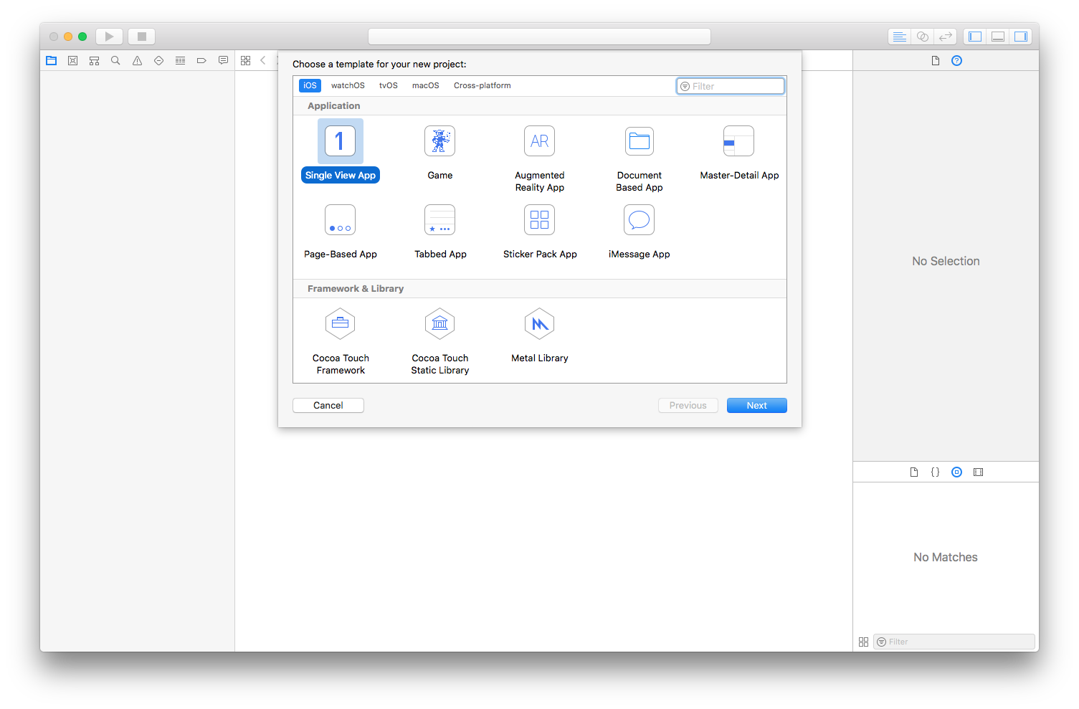
Create New Project

Slide 8
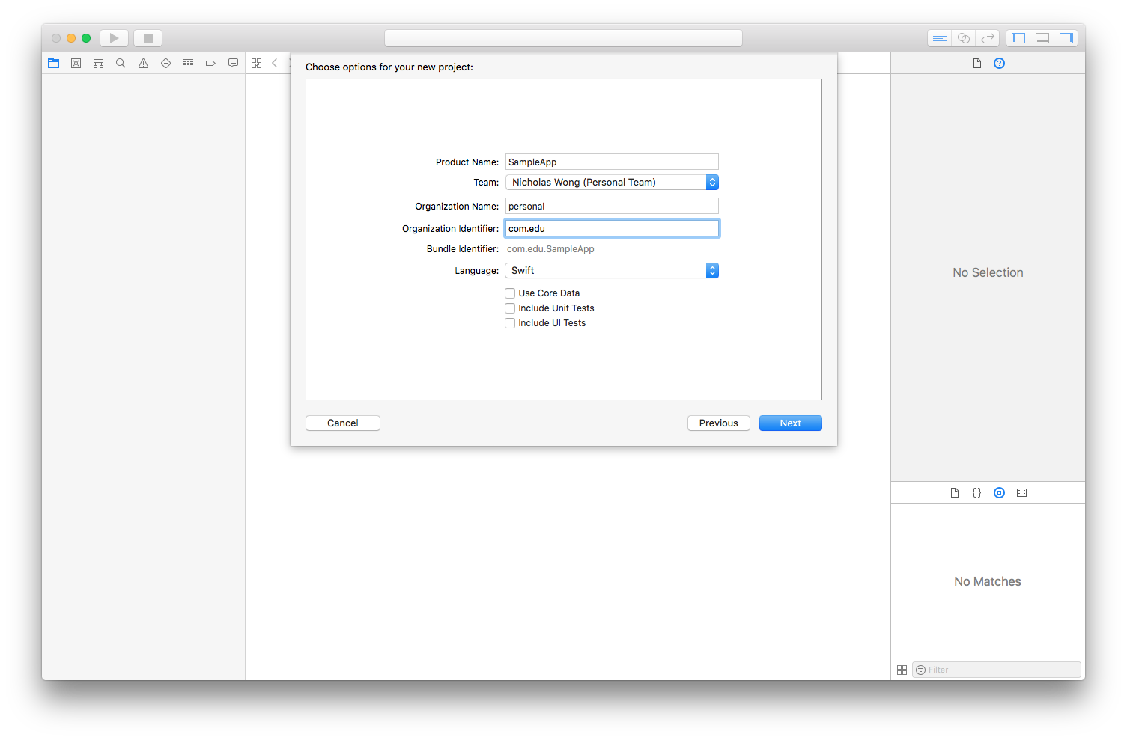
Create New Project

Slide 9
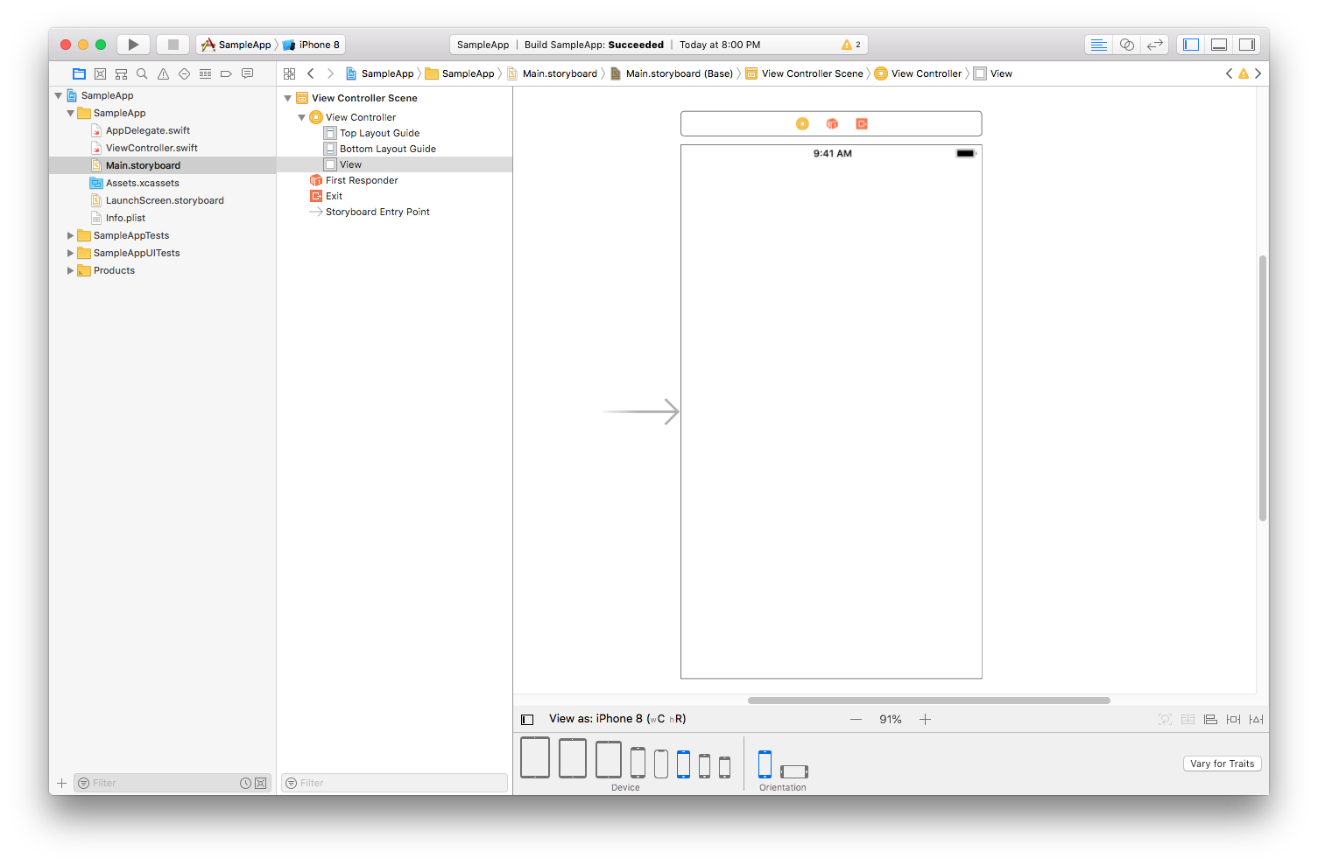
Storyboard

Slide 10
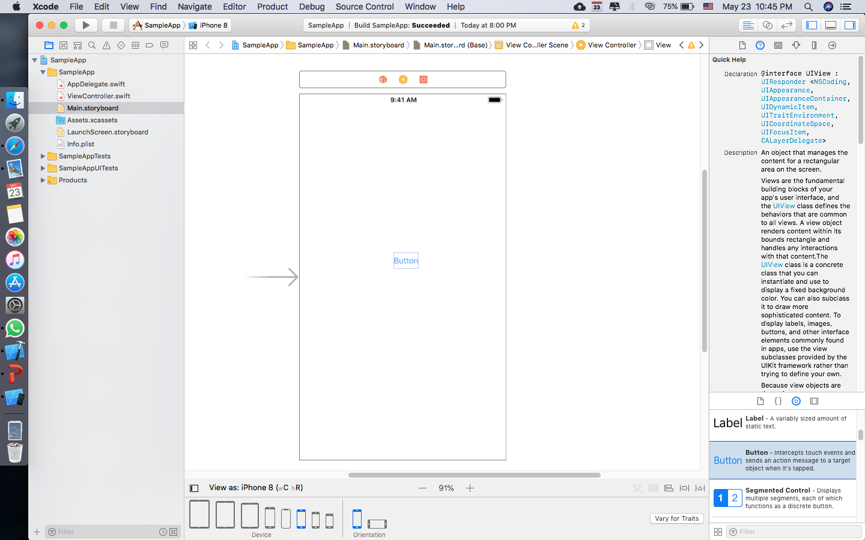
Adding A Button

Slide 11
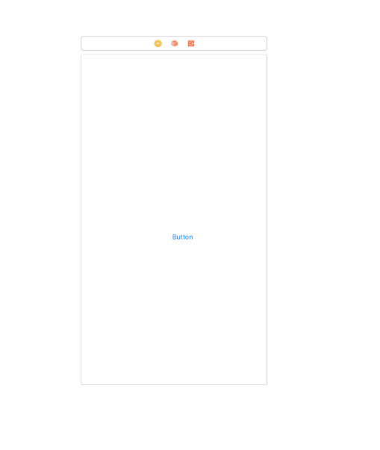
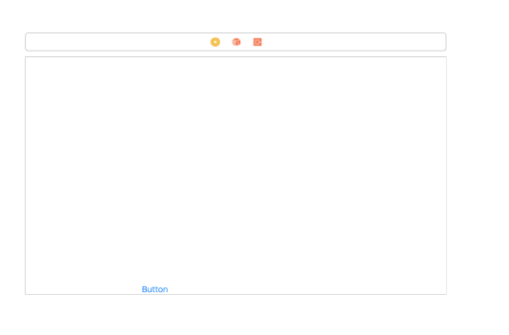
Layout Issue
The button is not at the right position on different devices/orientations

Slide 12
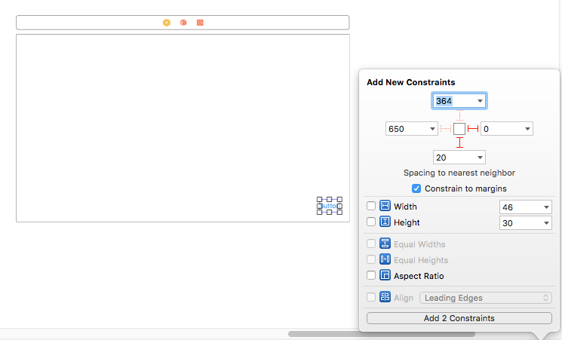
Pinning
Select the pinning icon to show the popup
Add 2 constraints to the bottom and right

Slide 13
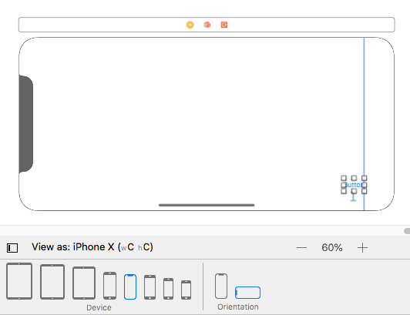
Preview
Preview the layout by selecting various devices and orientation at the bottom

Slide 14
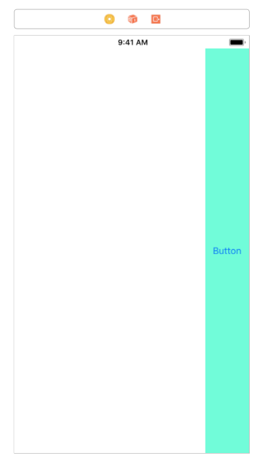
Use Constraint to Extend
Add a new constraint to pin the bottom button to the top edge
The button will extend from bottom to top

Slide 15
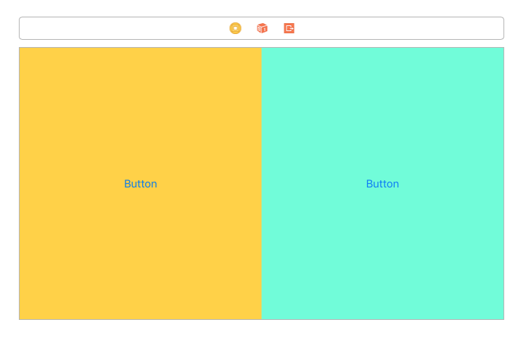
Ex: Pinning & Layout
Create two buttons side by side on all device sizes and orientations

Slide 16
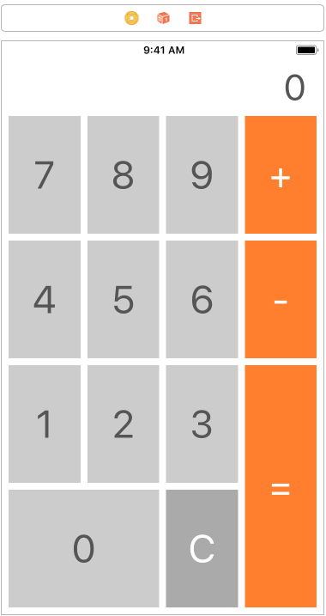
Challenge: Calculator Layout
Create a calculator layout like the one below
Time: 15 min

Slide 17
Hint to Challenge
Option + Drag to duplicate 16 buttons
Add constraints on equal spacing, width and height

Slide 18
Coding in Xcode Project

Slide 19
Connecting Code to UI element

Slide 20
Connect a Label to code
Add a Label to the storyboard from the object library
CTRL drag the Label to inside the ViewController class
Select Outlet and name it label
type label.text = “hi everyone” in the viewDidLoad function
Run the simulator

Slide 21
Adding variable
@IBOutlet weak var label: UILabel!
var name: String = “”
override func viewDidLoad() {
name = “alfred”
label.text = “My name is \(name)”
}

Slide 22
Challenge: Variable
Add two numerical variables a and b to ViewController class
Assign a = 2 and b = 5
Print 2+5 = 7 on the simulator
Time: 2 mins

Slide 23
Add Method
func sum(x:Int, y:Int) -> Int {
return x + y
}
override func viewDidLoad() {
a = 2
b = 5
label.text = “\(a) + \(b) = \(sum(x:a, y:b))”
}

Slide 24
Connect a Button to Code
Add a button to the storyboard from the object library and name it “Who Are You”
CTRL drag the label to inside the ViewController class
Select Action and name it “whoareyou”
Add the code:
@IBAction func whoareyou(_ sender: UIButton) {
label.text = “My name is Alvin”
}

Slide 25
Challenge: Button
Create a button
When user click a button, score increases by 1
Display the score on the label
Time: 10 min

Slide 26
Build a Simple Calculator App

Slide 27
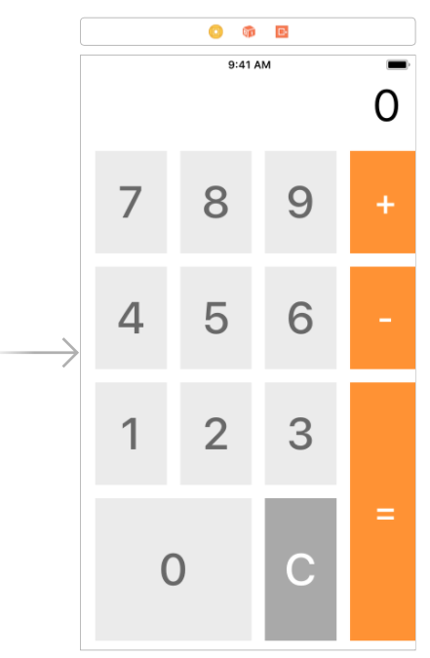
Calculator App Demo

Slide 28
App Plan
Tap numbers and see them on the top
Tap + or – button
Tap each Button for more numbers
Tap = to see result
Tap C to clear result

Slide 29
App Properties
Name | Type | Description
savedNum | Int | Used to hold numeric value entered
currentMode | Modes | Specify whether user is in adding or subtracting mode
lastButtonWasMode | Bool | True if Mode Button (+/-) is last pressed
labelString | String | The string version of the total
label | UILabel | The label at the top of the user interface

Slide 30
App Methods
Name | Description
tappedClear | Reset calculator when user presses C button
tappedNumber | User tap number button (0-9) and put numbers in label
tappedPlus | When user press + button, call changeMode
tappedMinus | When user press – button, call changeMode
tappedEqual | Display result in the label when user tap = button
changeMode | Changes mode to either addition or subtraction
updateText | Update text in label

Slide 31
Create Mode Enum
enum modes {
case not_SET
case addition
case subtraction
}

Slide 32
Setup Variables
var labelString:String = “0”
var currentMode:modes = modes.not_SET
var savedNum:Int = 0
var lastButtonWasMode:BOOL = false

Slide 33
Setup Methods
func tappedNumber(_ num:Int) {
}
func updateText() {
}
func changeMode(_ newMode:modes) {
}

Slide 34
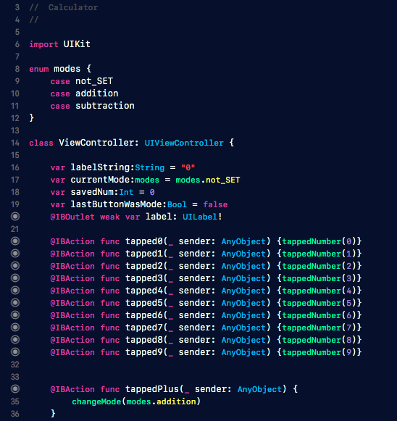
Connect UI Elements to Code
Connect all UI elements to code

Slide 35
Display Tapped Numbers
func tappedNumber(_ num:Int) {
labelString = labelString + “\(num)”
updateText()
}
func updateText() {
label.text = labelString
}

Slide 36
Avoid 0 to appear
func updateText() {
guard let labelInt:Int = Int(labelString) else {
label.text = “Int conversion failed”
return
}
label.text = “\(labelInt)”
}

Slide 37
Clear Button
@IBAction func tappedClear(_ sender: AnyObject) {
savedNum = 0
labelString = “0”
label.text = “0”
currentMode = modes.not_SET
lastButtonWasMode = false
}

Slide 38
Add and Subtract Buttons
@IBAction func tappedPlus(_ sender: AnyObject) {
changeMode(modes.addition)
}
@IBAction func tappedMinus(_ sender: AnyObject) {
changeMode(modes.subtraction)
}

Slide 39
Equal Buttons
@IBAction func tappedEquals(_ sender: AnyObject) {
guard let num:Int = Int(labelString) else {
return
}
if currentMode == modes.not_SET || lastButtonWasMode {
return
}
if currentMode == modes.addition {
savedNum += num
}
else if currentMode == modes.subtraction {
savedNum -= num
}
currentMode = modes.not_SET
labelString = "\(savedNum)"
updateText()
lastButtonWasMode = true
}

Slide 40
You’ve built your first working App!
🎉 🎉

